Slide 1
Modeling and Mapping Smart Grid Vocabulary
1

Slide 2
Challenge
How do we relate terms among the 20+ groups who have contributed their vocabularies to the Architecture Committee?
Sometimes the same word means different things
Sometimes different words mean the same thing
2

Slide 3
Approach
Collect terms to create a vocabulary set
Categorize terms by abstraction level
Conceptual
Logical
Physical
Categorize terms by type
Actor
Service
ServiceComposition
3

Slide 4
Approach (continued)
Clearly define some neutral terms in a neutral model
Why?
Because sometimes the distinctions are not clear when used by various groups
Trying to relate terms between two groups’ terms compounds this problem
e.g.
HomeEnergyManagementLogicalDevice (an Actor)
…as distinct from:
HomeEnergyManagementLogicalServices (a ServiceComposition)
…which might be composed of
EnergyMonitoring
LoadManagement
…
4

Slide 5
Approach (continued)
Map use case concepts to those terms
Map the collected vocabulary set to those terms
5

Slide 6
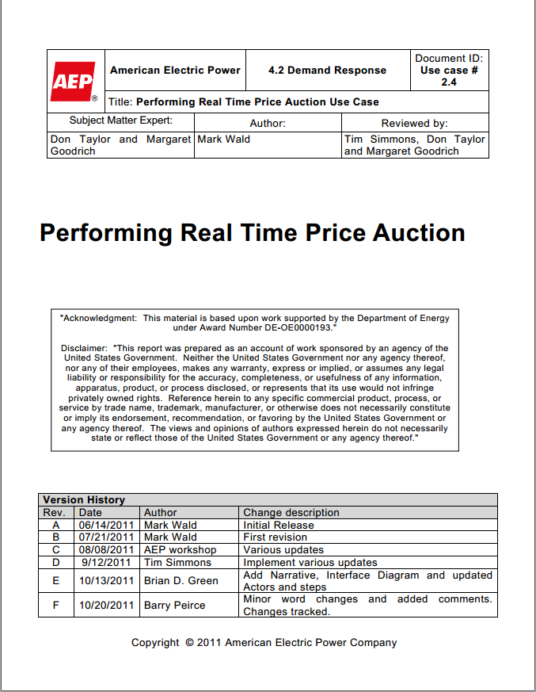
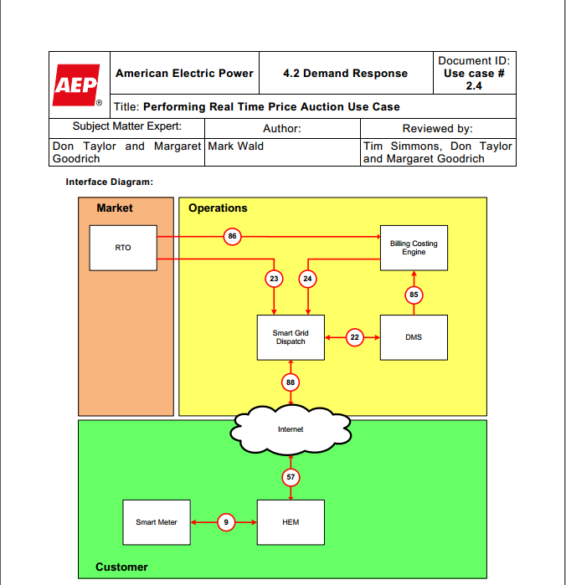
Mapping Use Case Terms
Let’s look at this term

Slide 7
The HEM in the AEP/EPRI use case
HEM stands for “Home Energy Management System”
What does that really mean?
Home Energy Management System
=
A piece of hardware and/or software
(an Actor)
…that performs a set of Services

Slide 8
The HEM in the AEP/EPRI use case
A piece of hardware and/or software
(an Actor)
There are different kinds of hardware.
What kind of hardware?
There are different grades of hardware.
Sensor hardware
Commercial grade
Actuator hardware
Industrial grade
Control hardware
Residential grade

Slide 9
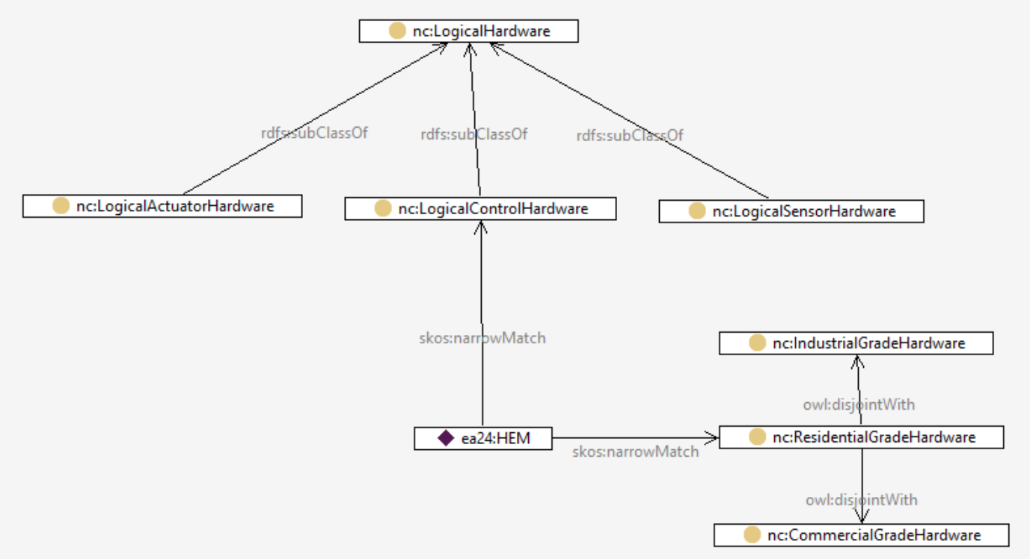
The HEM in the AEP/EPRI use case

Slide 10
The HEM in the AEP/EPRI use case
OK, we have characterized the hardware.
What about the Services it performs?
Home Energy Management System
=
A piece of hardware and/or software
(an Actor)
…that performs a set of Services

Slide 11
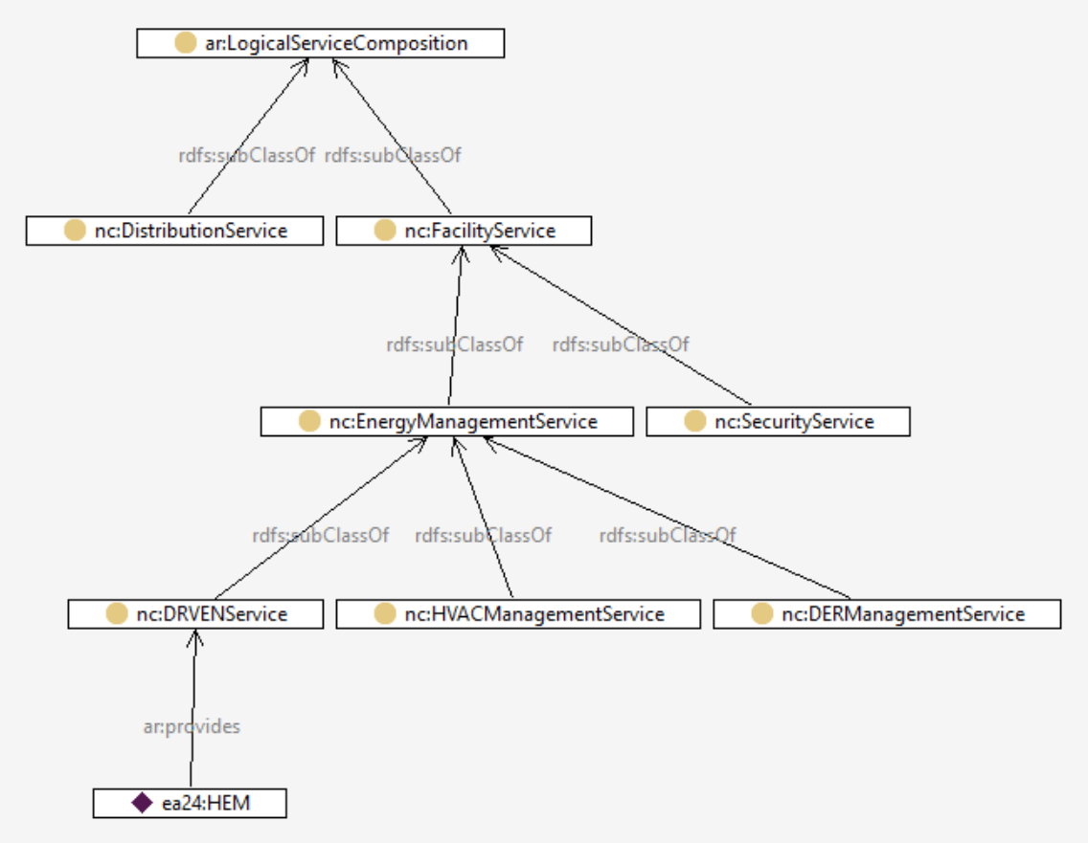
The HEM in the AEP/EPRI use case
Services
We can define a hierarchy of Services
For this DR use case, we know the HEM provides at least a DR service

Slide 12
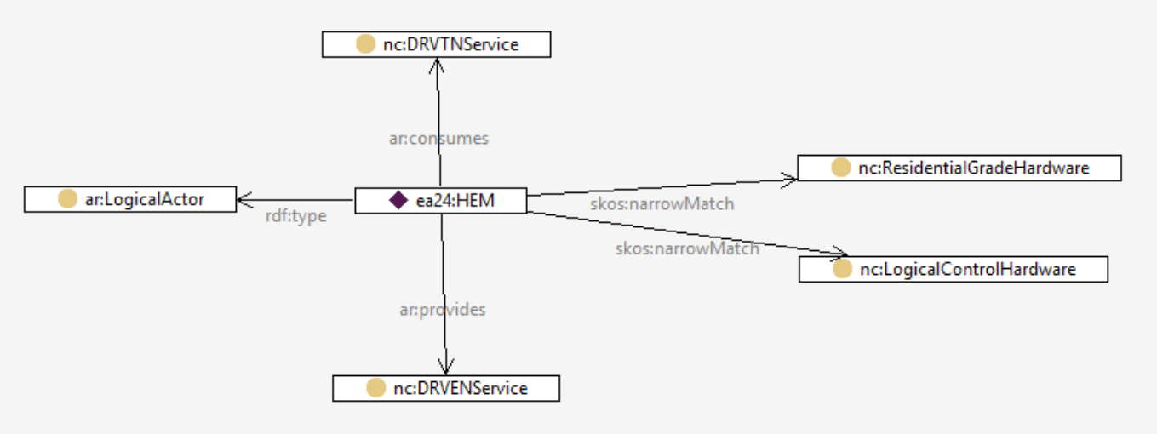
The HEM in the AEP/EPRI use case
Definition of HEM
So, a definition of the HEM in this use case might be captured as follows:

Slide 13
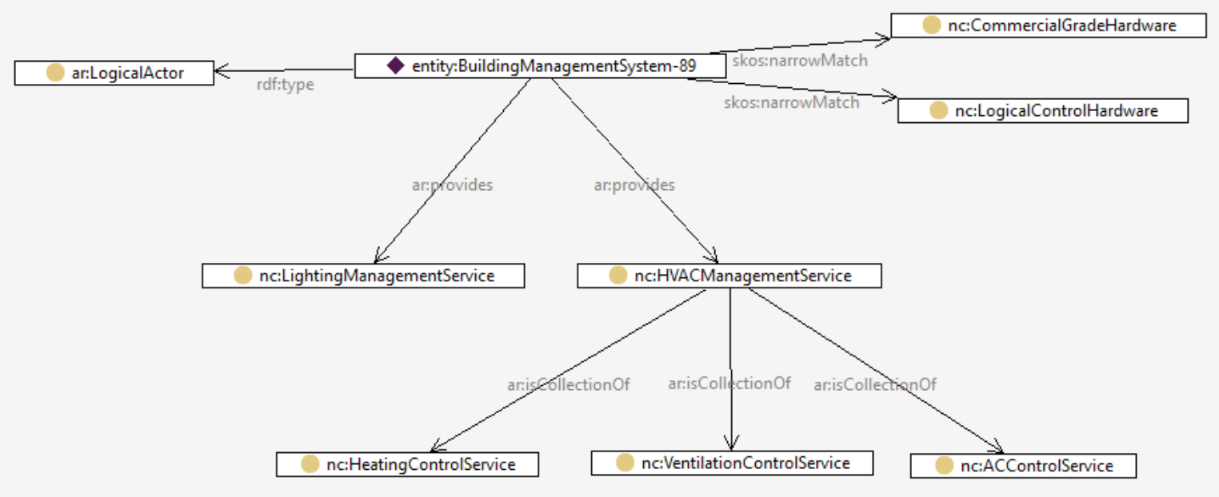
“BuildingManagementSystem”
Definition from the EU
A system consisting of several decentralized controllers and a centralized management system to monitor and control the heating, ventilation, air conditioning, light and other facilities within a building.

Slide 14
“BuildingManagementSystem”
How does this help? Because if you want to interface with something that provides HVACManagementService, then you are guaranteed that it can perform HeatingControlService (for example).

Slide 15
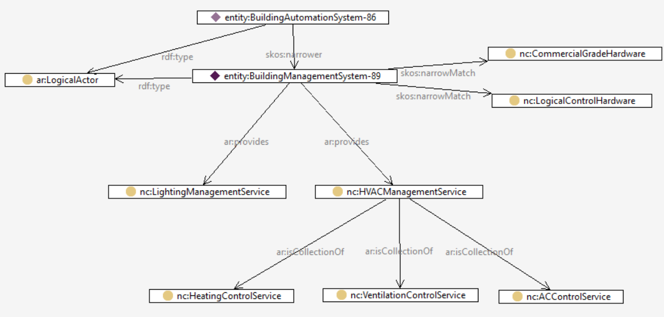
“BuildingAutomationSystem”
…and BuildingAutomationSystem can do everything BuildingManagementSystem can do because of the skos:narrower relation.
Actor (from CSWG NISTIR 7628)
Actor (from TC8 WG6)

Slide 16
Implications
If we correctly categorize systems and services, we can begin to identify where interoperability is possible, and where there will be problems.

